Slide 2
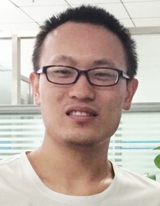
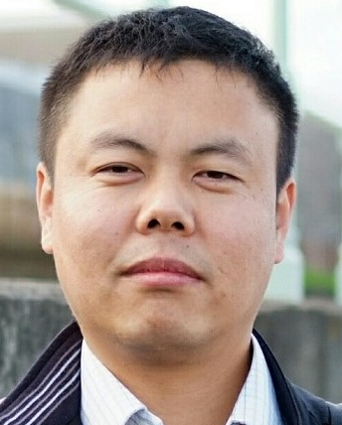

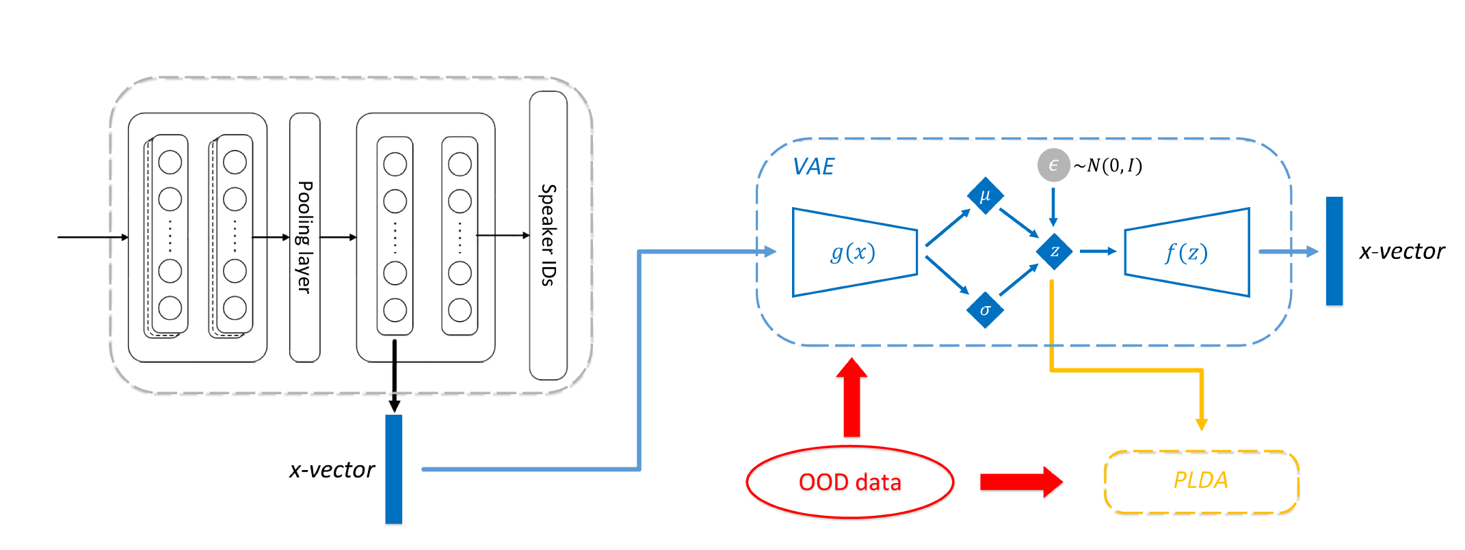
VAE-based Domain Adaptation for Speaker Verification
Xueyi Wang, Lantian Li, Dong Wang
CSLT, Tsinghua University
Speaker Recognition
Adapt x-vector to a new domain
1. A VAE-based distribution normalization.
2. Adapt to new domains based on the VAE.
Center for Speech and language Technologies (CSLT), Tsinghua University
Speech and language processing
Master/Phd candidates, Post-doc fellows, Interns with collaborative supervision
1. VAE can project unconstrained distribution
of x-vector to a Gaussian
2. Adaptation based on VAE can improve performance in an unsupervised way.
pengyt@cslt.org

Slide 4
VAE-based Domain Adaptation for Speaker Verification
Xueyi Wang, Lantian Li, Dong Wang
CSLT, Tsinghua University
Speaker Recognition
Adapt x-vector to a new domain
1. A VAE-based distribution normalization.
2. Adapt to new domains based on the VAE.
Center for Speech and language Technologies (CSLT), Tsinghua University
Speech and language processing
Master/Phd candidates, Post-doc fellows, Interns with collaborative supervision
1. VAE can project unconstrained distribution
of x-vector to a Gaussian
2. Adaptation based on VAE can improve performance in an unsupervised way.
pengyt@cslt.org

